Slide 1
PRDA- 01 Profit Analysis.
Capstone project.

Slide 2
Capstone Project.
09-JUN-25-CDA-BUN-040-WDM0930-PUN
09-JUN-25-CDA-BUN-040-WDM0930-PUN
Project ID: PRDA-01
Name: Darshana Pawar & Prabhati Karn
Tools: Python and Power BI
Team ID: PTID-CDA-DEC-25-1028
Batch ID: 09-JUN-25-CDA-BUN-040-WDM0930-PUN.
&
09-JUN-25-CDA-BUN-040-WDM0930-PUN

Slide 3

Contents.
Introduction & business Objective.
Dataset Overview.
Methodology(Regression Approach)
Key KPI & Matrices.
Dashborad Overview.
Spending Empact on Profit.
State-wise profit.
Key Insights.
Business recommendation.
Conclusion.

Slide 4

Introduction.
This project analyzes how RD spend, Marketing spend, Administration spend impacting on profit. There is input given by the client according to the expenditure, the profit is explained. The results are visualized in power BI tool. The aim of the project is to analyse, on which spending we need to focus for gaining profit, with the help of the visualization we will be able to get to know about which spending increasing the profit and which spending has least impact on it. Our objective of this study is to optimize budget allocation and take financial decision for our business to make it profitable.

Slide 5

Dataset Overview.
The dataset in the project contains 5 columns and 50 rows. It also contain 3 states that is new York, California, Florida. It captures various types of company expenditure along with resulting profit. On this dataset we have perform regression analysis to make a precise decision on spending on business. This dataset also contains 0 values, using python we have replaced 0 values with mean.
Dataset details:
No. of records: 50 rows and 5 columns.
States: California, Florida, New York
Datatype: Numeric and categorical
Total sending: RD spending, Marketing spending, Administration spending
Null Values: No

Slide 6

Regression analysis.
Regression analysis is used in this project to understand the relationship between company spendings and profit and to predict profit on the given inputs.
Project contain:
Multiple linear regression
Dependent variable: Profit
Independent variable: RD spend, Marketing spend, Administration spend and state
Interpretation:
A higher Coefficient indicates strong impact on profit.
A positive coefficient means increase in spending in increasing profit.
Low or negative coefficient indicates to low or decrease in profit.
If P value > 0.05 the value is significant and if P value < 0.05 the value is not significant.

Slide 7
KEY KPI and Matrices.
Key performance indicators are:
Total Profit: ₹56,00,631.96.
Total RD spend: ₹ 38,39,667.48
Total Marketing spend: ₹ 112,24,739.2
Spending Matrices:
Total RD Spending: ₹ 21,892.92, ₹ 23, 940.93
Total Administration spending: ₹ 81,910.77, ₹ ₹ 96489.63
Total Marketing Spending: ₹ 1,64,270.70, ₹ 1,37,001.1
Total predicted Profit:
1) Profit: ₹ 2,68,074.39, ₹ 257431.66

Slide 8
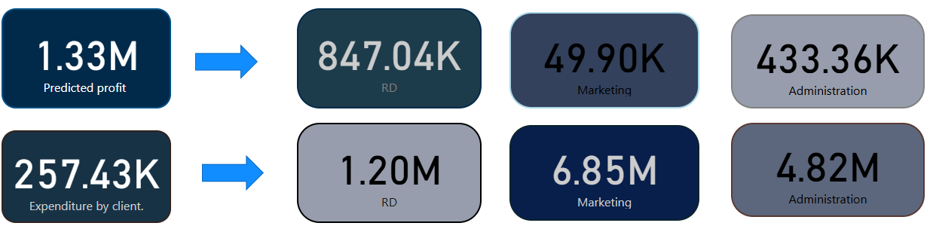
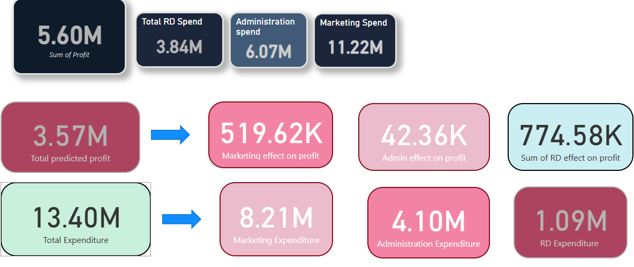
Dashboards overview.
This dashboard provides the information on how RD, marketing, administration spending influence profit across different states.
Key elements:
1) KPI card is showing the total profit, total expenditures. On the second sheet the KPI card is showing total predicted profit according to the spending. The KPI card also contain the input values given by the client.

Slide 9
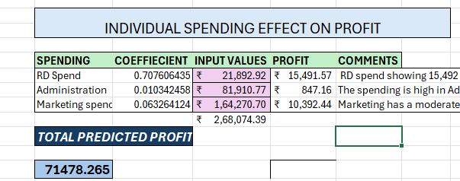
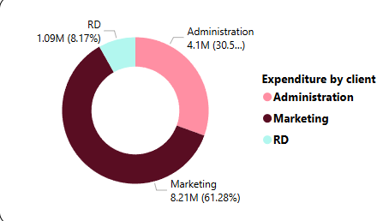
Expenditure by customer. (Task 1)
RD Expenditure: ₹ 21892.92
Administration Expenditure: ₹ 81910.77
Marketing expenditure: ₹ 164270.7
As per to the expenditure by the customer we can see that the total predicted profit is 71478.265.
Upon checking the figure, here we can see that on RD customer has invested less as compare to administration and marketing.
Further we will check how investment impact on profit and which one will be more beneficial for the business.

Slide 10
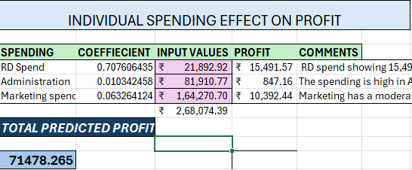
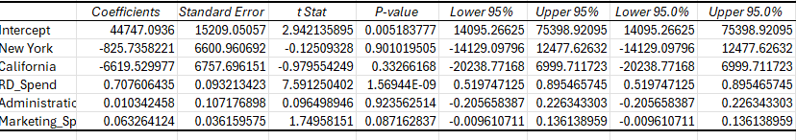
Regression analysis (Task1).
R&D Spend:
Coefficient = 0.77
P-value<0.05
✅ Statistically significant.
Marketing spend:
Coefficient = 0.03
P-value<0.05
✅ Statistically significant.
Administration Spend:
Coefficient spend= 0.01
P-value>0.05
❌ Not statistically significant.

Slide 11
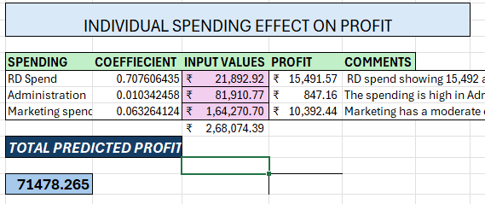
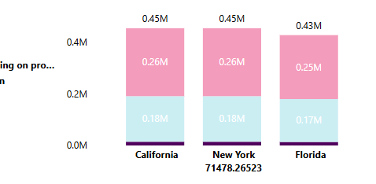
Profit Prediction explanation. (taks1)
Key Insights:
R&D spending is the most impactful drive of profit.
Marketing contributes positively but with lower effectiveness.
Administration spending has minimal influence.
Our regression model clearly shows that R&D investment delivers the highest return on profit, while administrative expenses contribute the least.

Slide 12
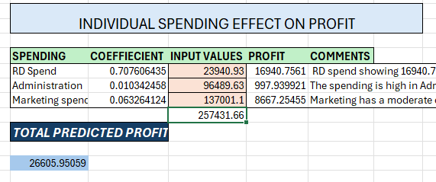
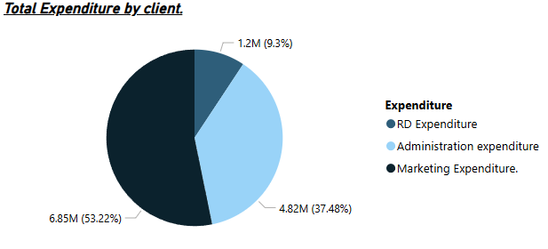
Expenditure by customer. (Task 2)
RD Expenditure: ₹ 23940.93
Administration Expenditure: ₹ 96489.63
Marketing expenditure: ₹ 137001.1
As per to the expenditure by the customer we can see that the total predicted profit is ₹ 26605.95059.
Upon checking the figure, here we can see that on RD customer has invested less as compare to administration and marketing.
Further we will check how investment impact on profit and which one will be more beneficial for the business.

Slide 13
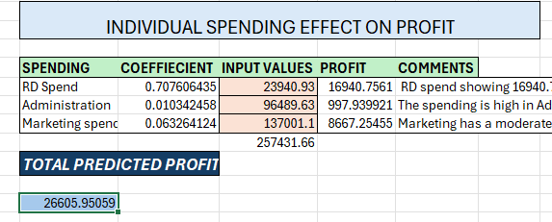
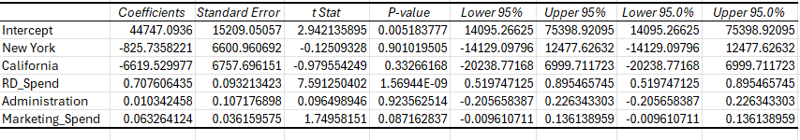
Regression analysis (taks2).
R&D Spend:
Coefficient = 0.70
P-value<0.05
✅ Statistically significant.
Marketing spend:
Coefficient = 0.01
P-value= 0.08
✅ Statistically significant.
Administration Spend:
Coefficient spend= 0.01
P-value>0.05
❌ Not statistically significant.

Slide 14
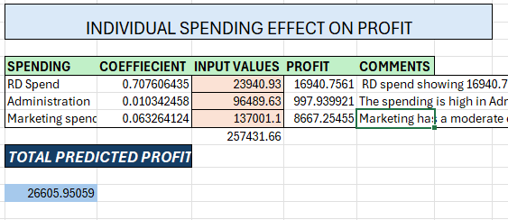
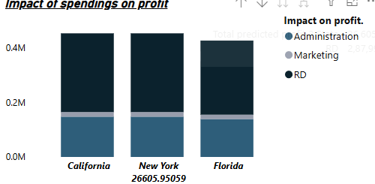
Profit Prediction explanation. (task 2)
Key Insights:
R&D spending is the most impactful drive of profit.
Administration contributes positively but with lower effectiveness, the p value> 0.05 it is not statistically significant.
Marketing spending has minimal influence, as p value is 0.08, we can keep this as option but not much effective on profit.
Our regression model clearly shows that R&D investment delivers the highest return on profit, while administrative expenses contribute the least.

Slide 15
Conclusion.
The analysis confirms that strategic spending, especially in R&D, is the key of sustainable profit growth.

Slide 16
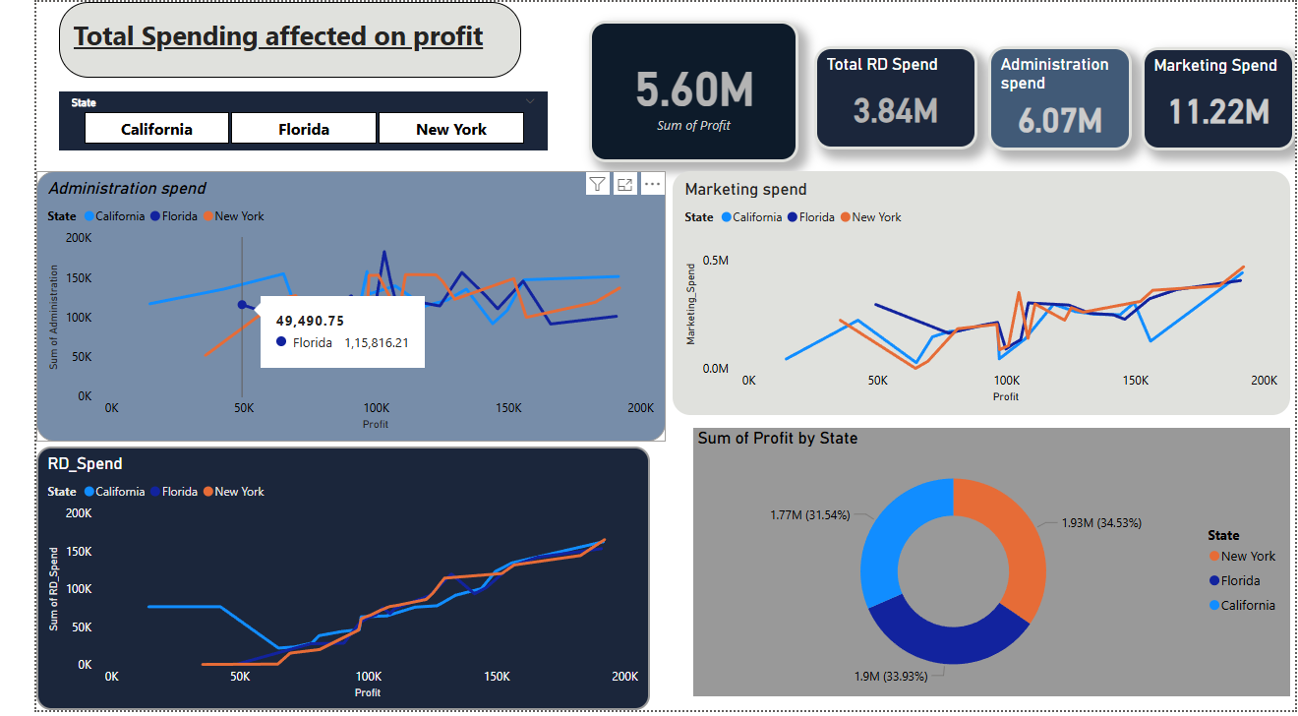

Slide 17
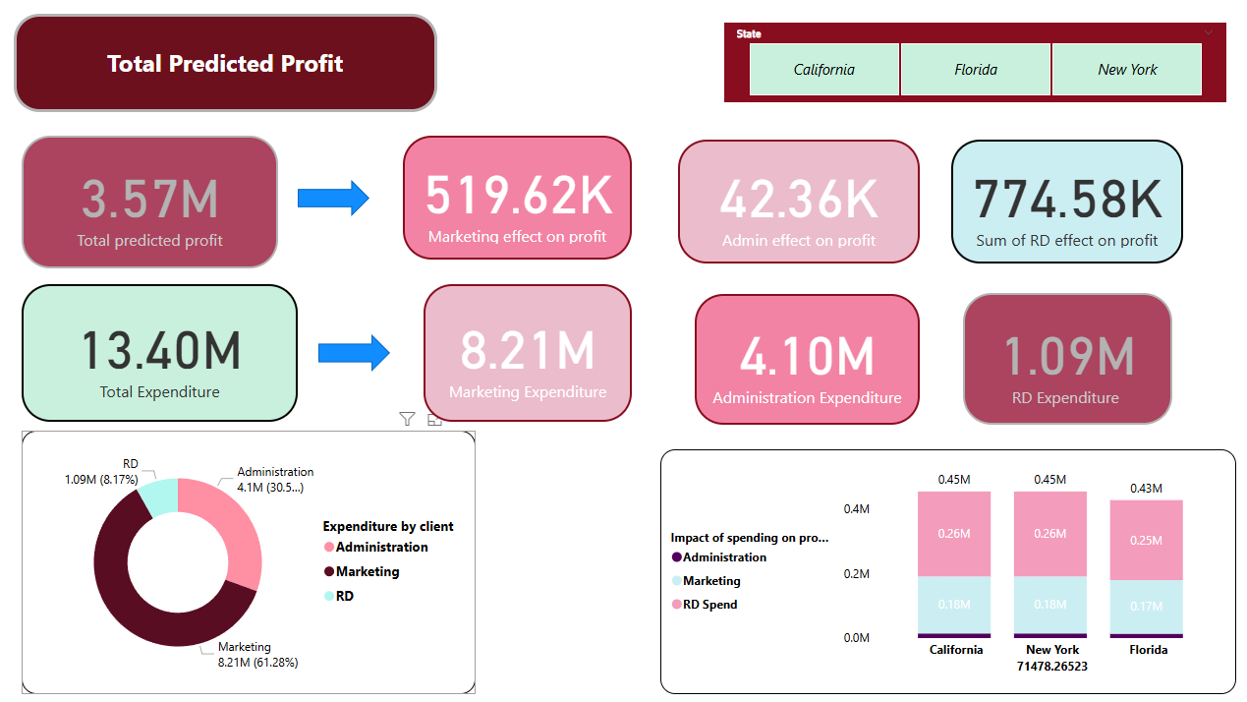

Slide 18
